Slide 1
Digital Portfolio
STUDENT NAME: B.VIGNESHWARAN
REGISTER NO AND NMID: 31924U09027
DEPARTMENT:B.C .A
COLLEGE: COLLEGE/ UNIVERSITY:Mazharul uloom college [Autonomous]/Thiruvalluvar UNIVERSITY

Slide 2
PROJECT TITLE
DIGITAL PORTFOLIO
SHOWCASE OF WORK – A digital portfolio helps to present personal, academic, and professional details in an organized way.
EASY ACCESS – It allows others (teachers, recruiters, or companies) to easily view achievements and skills online.
PROFESSIONAL PRESENTATION – It highlights projects, certifications, and talents in a professional format.
CAREER SUPPORT – Useful for academic evaluations, internships, and future job opportunity

Slide 3


AGENDA
Problem Statement
Project Overview
End Users
Tools and Technologies
Portfolio design and Layout
Features and Functionality
Results and Screenshots
Conclusion
Github Link
3/21/2024 Annual Review

Slide 4

PROBLEM STATEMENT
The “Problem Statement” in a project or research clearly defines the issue you are trying to solve. It sets the foundation for your study or project. Here’s the meaning explained in points:
Gives Context – Provides background information so the reader understands the situation
Highlights Impact – Explains the negative consequences of not solving the problem.
Justifies the Need – Shows why solving this problem is important (social, technical, educational, environmental, etc.).

Slide 5

PROJECT OVERVIEW
A Project Overview is a short summary of the project that explains what it is about, why it is important, and how it will be carried out. It gives a clear idea of the project at a glance.
Project Title – The name of the project.
Introduction – A brief explanation of the topic or idea.
Overview of project :The name of the project digital portfolio and using the project overview

Slide 6

WHO ARE THE END USERS?
End users are the final people who actually use a product, system, or service.
They are different from developers, administrators, or intermediaries because
they directly interact with the finished output.
In software development → End users are the people who install and use the
app on their phone or computer.
In education technology → Students and teachers using a learning app are the
end users.
In an e-commerce website → Shoppers buying products online are the end users.

Slide 7

TOOLS AND TECHNIQUES
Tools
IOT Hardware – Sensors (ultrasonic, weight), microcontrollers (Arduino/Raspberry Pi).
Software Platforms – Cloud services (ThingSpeak, Firebase), programming (C, Python).
Techniques
Real-time Monitoring – Wireless data transfer from bins to cloud/mobile app.
Automation & Alerts – Automatic notifications and optimized waste collection routes.
Would you like me to also make this in a very crisp table format (Tools vs Techniques) for your project file

Slide 8
POTFOLIO DESIGN AND LAYOUT
Cover Page – Title, Name, Register Number, Department, College.
About & Project Details – Profile, Project overview, objectives, tools, and techniques.
Skills & Achievements – Technical skills, certifications, and strengths.
Conclusion & Contact – Future scope, summary, and contact details.
Do you want me to also make this in a clean table format (Section → Content) for quick portfolio setup?
8

Slide 9
FEATURES AND FUNCTIONALITY
Real-time Monitoring – Sensors track waste level in bins.
Automatic Alerts – Notifications sent when bins are full.
Data Visualization – Dashboard/app shows waste status and reports.
Optimized Collection – Route planning for efficient garbage pickup.
Do you want me to make this in a table format (Feature → Functionality) for your portfolio?

Slide 10
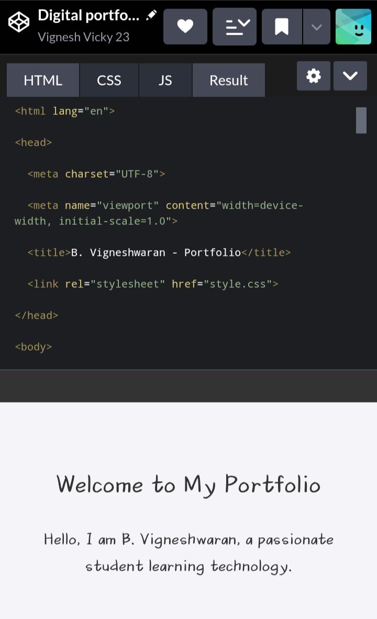

RESULTS AND SCREENSHOTS
Project Results
The portfolio website was successfully designed and developed with a user-friendly layout.
All key sections such as About Me, Skills, Projects, and Contact Information were included and displayed clearly.
The project demonstrates the ability to use HTML, CSS, and JavaScript for building a functional and responsive website.
The portfolio highlights academic details, technical skills, and personal achievements in a professional manner.
The final output is a well-structured digital portfolio that can be shared with recruiters, teachers, and peers.
3/21/2024 Annual Review
10

Slide 11
CONCLUSION
The Digital Portfolio Project serves as a structured platform to showcase my academic details, technical skills, and project work in a professional manner. It highlights my abilities, achievements, and practical knowledge through a well-organized layout. This portfolio not only reflects my learning journey but also acts as a reference for future career opportunities and personal growth.
11

